Slide 1
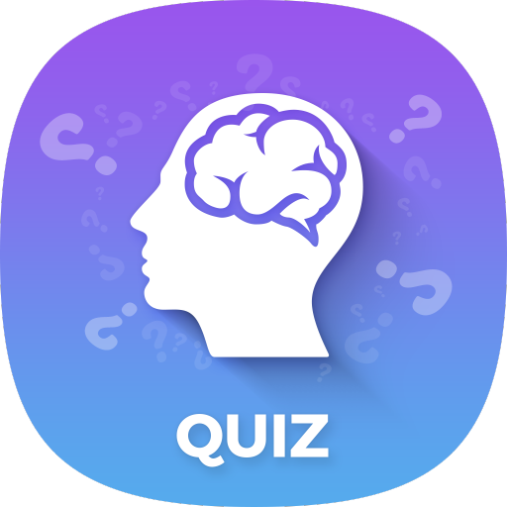
Quiz App

Slide 2




Team Members:
Keerthi Sree Kukunoor
Venkata Sai Krishna Dasari
Sachin Setty
Mouni Krishna Atluri

Slide 3
Introduction to the problem
There are various users who are taking the quizzes in various fields to improve their knowledge.
We found that there are lot of websites which provides quizzes but there are no applications for quizzes.
Sachin Setty​

Slide 4
Proposed Solution
So we come with an idea in developing an application that which can provide the various kinds of quizzes.
By installing this application the users can be able to take the quizzes when they want to test their knowledge.
This application was embedded with the lifetime statistics of the user. So that the users can be able to see their overall performance and their improvements.
Sachin Setty​

Slide 5
List of features and their completion status
First time user must register into the app for free.
The user must login into the app every time they use.
This app provides various categories of quizzes where the user can choose any.
Each categories contains 20 multiple choice questions where these questions are randomly generated each time.
The user's data is stored in the cloud database.
User can attempt the quiz with no limits.
User can be able to overview their written quiz.
Sachin Setty​

Slide 6
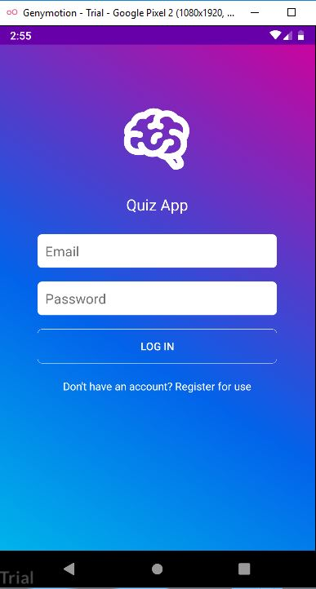
SCREEN SHOTS home page
This page contains the user login by using their credentials
First time can register into the app.
Keerthi Sree Kukunoor​

Slide 7
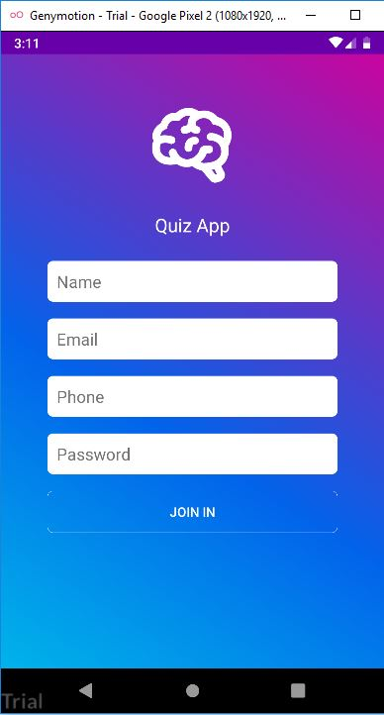
Registration page
The User can register into the app by using their name, email, mobile number and password.
Keerthi Sree Kukunoor​

Slide 8
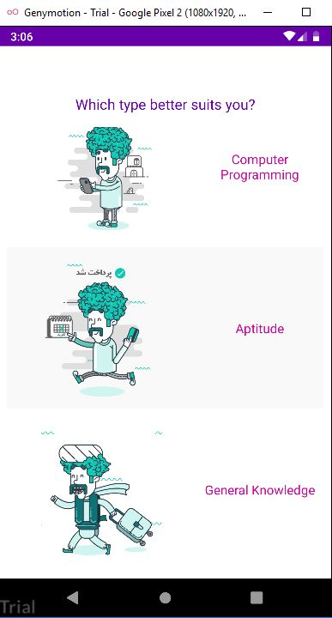
Categories Page
Once the user gets login into the app they can choose the category that they want to take the test.
Keerthi Sree Kukunoor​

Slide 9
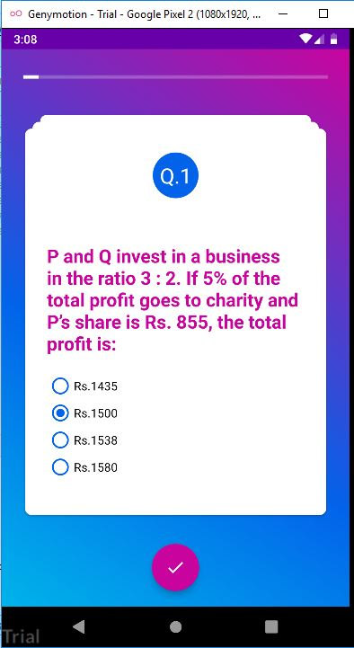
Questions displayed
Once the user choose the category the page will be redirected to questions page.
Here multiple-choice questions are randomly generated.
The questions are limited to 20 for each category.
Keerthi Sree Kukunoor​

Slide 10
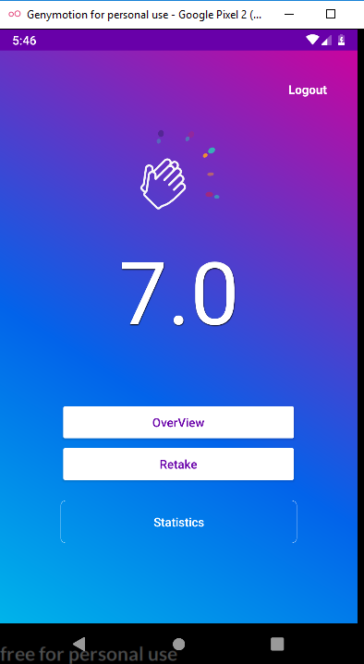
Score Display Page
The score will be displayed in this page.
This page also contains the Overview button, Retake button and lifetime statistics button.
Keerthi Sree Kukunoor​

Slide 11
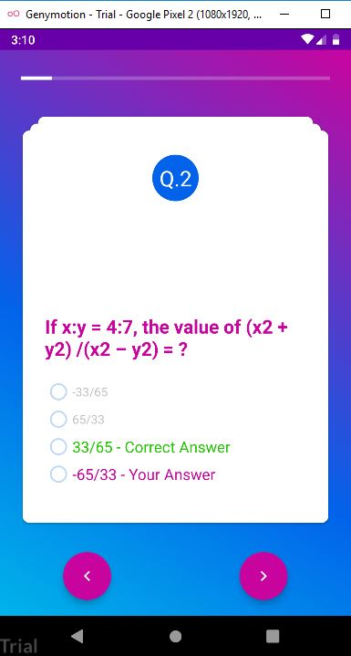
Overview of Questions
The Overview option provides the user with reviewing of their test.
So that the user can be able check the answers.

Slide 12
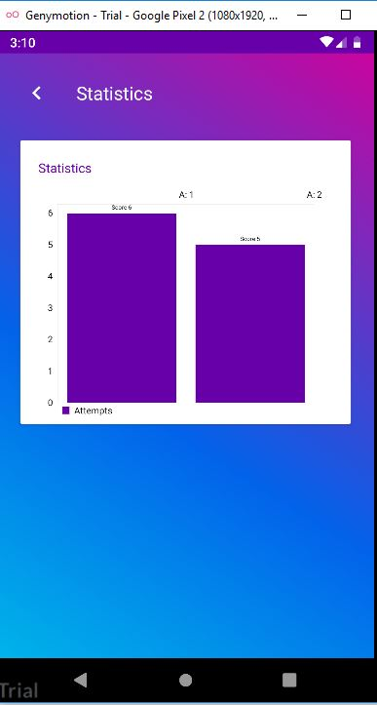
Statistics Page
This page provides the lifetime statistics of their exam results.
The lifetime statistics of their analysis is shown in bar-graph representation.
Keerthi Sree Kukunoor​

Slide 13
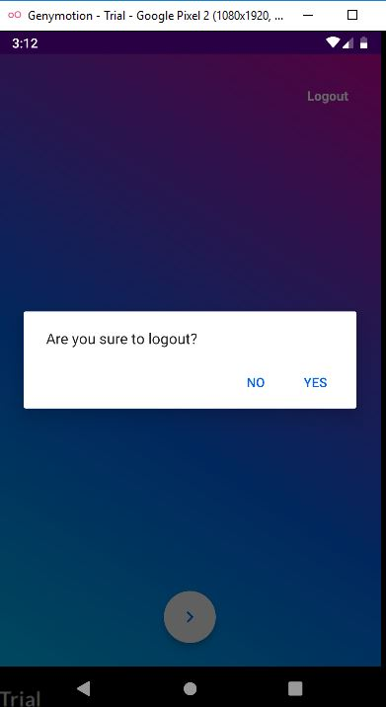
Logout Functionality
The user can logout from the app where they wants.
The user can log out either in welcome page or at scorepage.
Keerthi Sree Kukunoor​

Slide 14
Database and Persistency
The app uses the Firebase to store the data.
The questions are fetched from the Firebase while using the app and also the user credentials are stored here.
API/Library used in the Application
This app uses Firebase API.
This application is supported with minimum SDK version: API 21: Android 5.0(Lollipop) or above
Gradle version : 4.10.1
Android plugin version: 3.3.1
Venkata Sai Krishna Dasari

Slide 15
Problems Faced:
Adding the firebase Library and understanding its usability.
Connecting to Firebase is one of the most challenging part.
Lot of problems faced while adding the login page.
Random generation of questions.
Venkata Sai Krishna Dasari

Slide 16
Future Improvements:
Adding more categories in the application.
Adding the forget password verification link.
Sending their results to thier mobile.
We would like to get the feedback from the user.
Venkata Sai Krishna Dasari

Slide 17
Demo
Mouni Krishna Atluri

Slide 18
References:
https://firebase.google.com/docs/android/setup
https://code.tutsplus.com/tutorials/android-ui-workshop-build-an-interactive-quiz-app--mobile-14208
https://developer.android.com/training/basics/firstapp/building-ui
http://www.codebind.com/android-tutorials-and-examples/android-studio-android-login-screen-example/

Slide 19

THANK YOU

